Slide 1
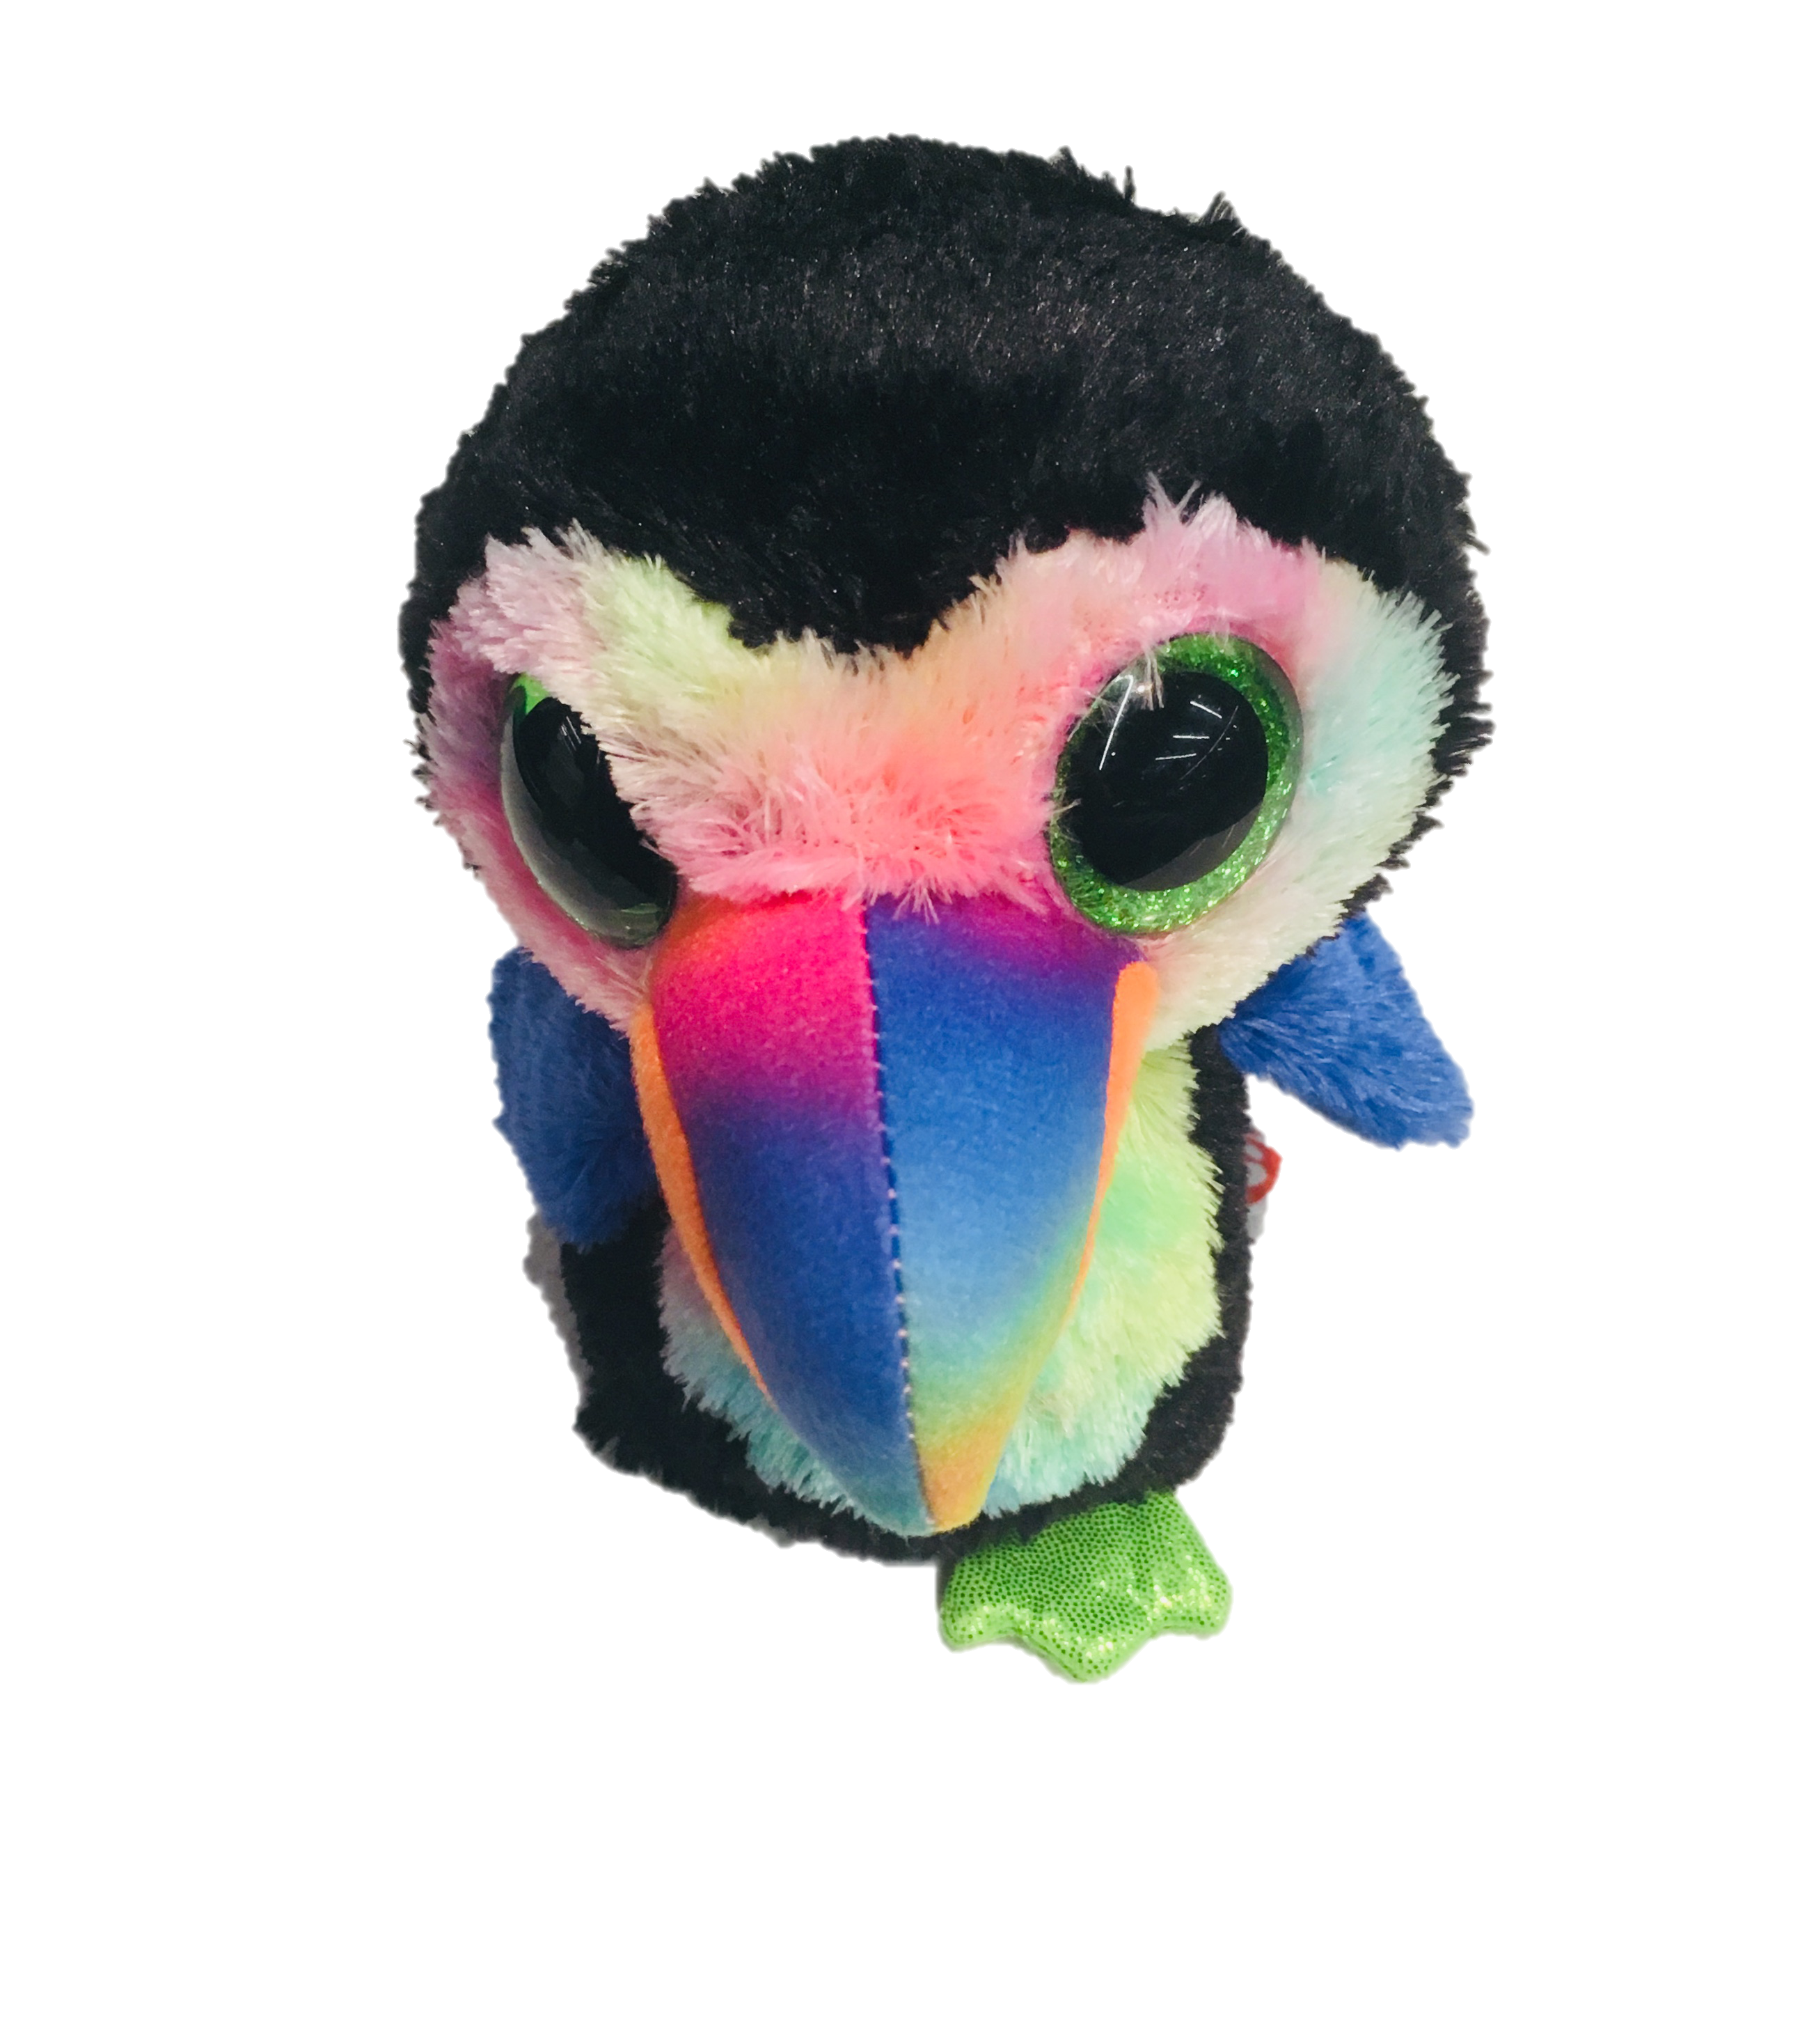
oTree workshop
Philipp Chapkovski
European University Institute
Brussels
July 11-12, 2018

Slide 2
oTree
link to follow:
http://bit.ly/brussels-otree
code for this game:
https://github.com/chapkovski/negotiations_exley

Slide 3
oTree
platform to run interactive online experiments
written on Python
open source
based on Django framework
responsive – can be run in mobile browsers, tablets etc.
Materials and code for this workshop: | https://chapkovski.github.io/teaching/brussels_2018/brussels_presentations/
My e-mail: | chapkovski@gmail.com
oTree support group: | https://groups.google.com/forum/#!forum/otree
oTree documentation: | http://otree.readthedocs.org/
general coding help: | https://stackoverflow.com

Slide 4
Outline
Guess random number game
Ultimatum game
Public good game
Deployment (Heroku, mTurk)

Slide 5


Our main goal:
Show something to the participant.
Get his/her reaction on it

Slide 6
Models
Pages
Templates

Slide 7
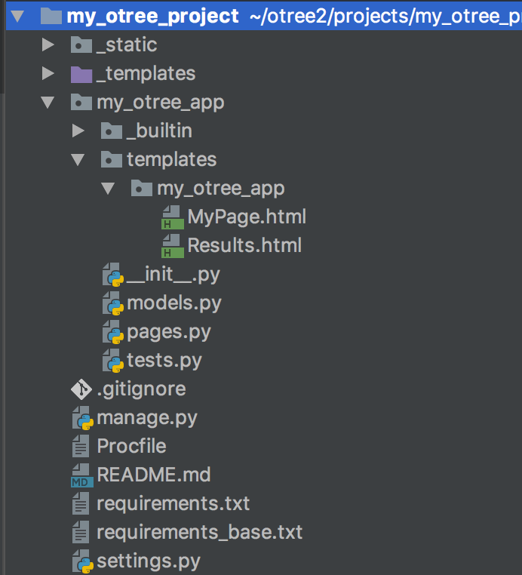

Slide 8
Models are responsible for storing and processing data in the database
Anything that you need to be stored should be defined as a field in models.py file
Models
Pages
Templates

Slide 9
Pages are responsible for retrieving and passing back data from models to templates and vice versa.
If you need to show something to a participant or to get his/her input, you need to state in pages.py
Models
Pages
Templates

Slide 10
Templates are just ordinary html files which get the info from pages and show it to a participant.
As soon as a participant clicks ‘Next’ the data he enters is passed back to pages
Models
Pages
Templates

Slide 11

This is session.
The entire set of all participants in your lab
or online

Slide 12
This is participant.
The entire set of all participants in your lab
or online

Slide 13
Subsession
is a set of all players in one round

Slide 14
Player is an element of
subsession

Slide 15
One participant
contains the info
about all players
who he/she
‘owns’

Slide 16
The group
is a set of players
in one particular
subsession

Slide 17
One session can contain several apps

Slide 18
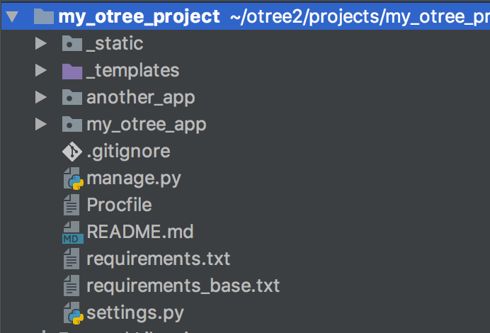
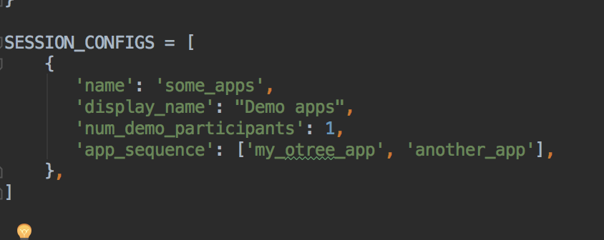
One session can contain several apps
in settings.py:

Slide 19
the first oTree app
Open the terminal (MacOS), or PowerShell/Command line (Windows)
Check if oTree is installed: otree –version
Create a new project: otree startproject NAMEOFPROJECT
Create a new app:
Change to NAMEOFPROJECT folder: cd NAMEOFPROJECT
Create an app: otree startapp NAMEOFAPP

Slide 20
the first oTree app
Open NAMEOFPROJECT in PyCharm (or in any other editor of your choice)
register app to settings.py:
SESSION_CONFIGS = [ { 'name': 'my_first_app', 'display_name': "My First App", 'num_demo_participants': 1, 'app_sequence': ['my_first_app'], }, ]
In Terminal: otree devserver
in any browser go to: http://127.0.0.1:8000

Slide 21

Very brief introduction

Slide 22
Structure of oTree app
Pages
Page classes
page_sequence
Models
Constants
Player, Group, Subsession
App definition in settings.py
Displaying logic
Data processing

Slide 23
models.py
Constants: fixed set of global parameters, remaining the same for the entire app
Subsession model: data that can change from session to session and from round to round, for the entire set of participants in the specific session
Group model: data that remains the same for the group of players in the specific round (example: total contribution in PGG, Sender's decision in DG/TG)
Player model: data for individual decision makers

Slide 24
models.py
class Constants(BaseConstants): # Base constants of oTree name_in_url = 'myotreeapp' players_per_group = 2 num_rounds = 1 # Any custom parameters: endowment = 100 class Subsession(BaseSubsession): treatment = models.StringField(initial='baseline') class Group(BaseGroup): total_investment = models.IntegerField(initial=100) class Player(BasePlayer): contribution = models.IntegerField(initial=10)

Slide 25
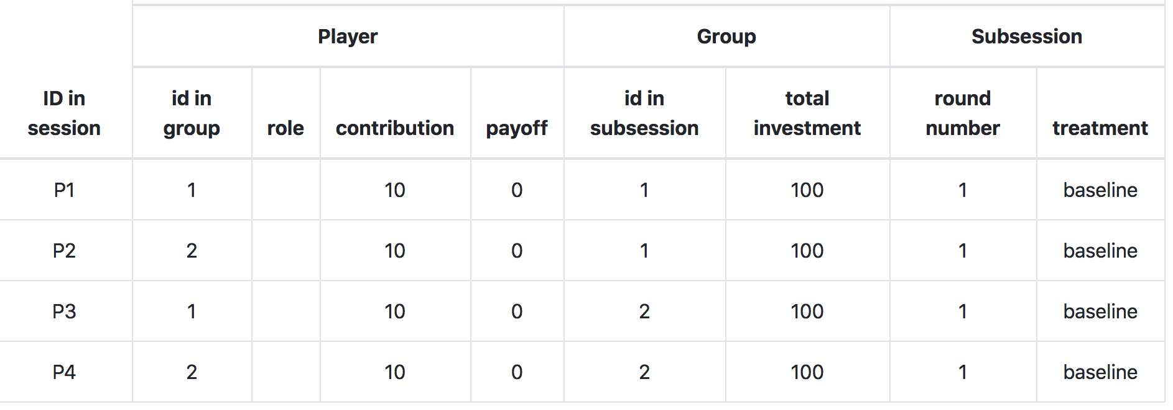
models.py

Slide 26
creating_session method
Subsession model has a special method creating_session
The code there will be executed just before the session starts.
It will be executed as many times as many rounds the game has.
It is used for randomizing initial values and assign treatments
Subsession model also has two other methods:
get_players()
get_groups()

Slide 27
creating_session method
The following code will randomize total investment per group and contribution per individual player:
import random class Subsession(BaseSubsession): def creating_session(self): for g in self.get_groups(): g.total_investment = random.randint(0, 100) for p in self.get_players(): p.contribution = random.randint(0, 10)

Slide 28
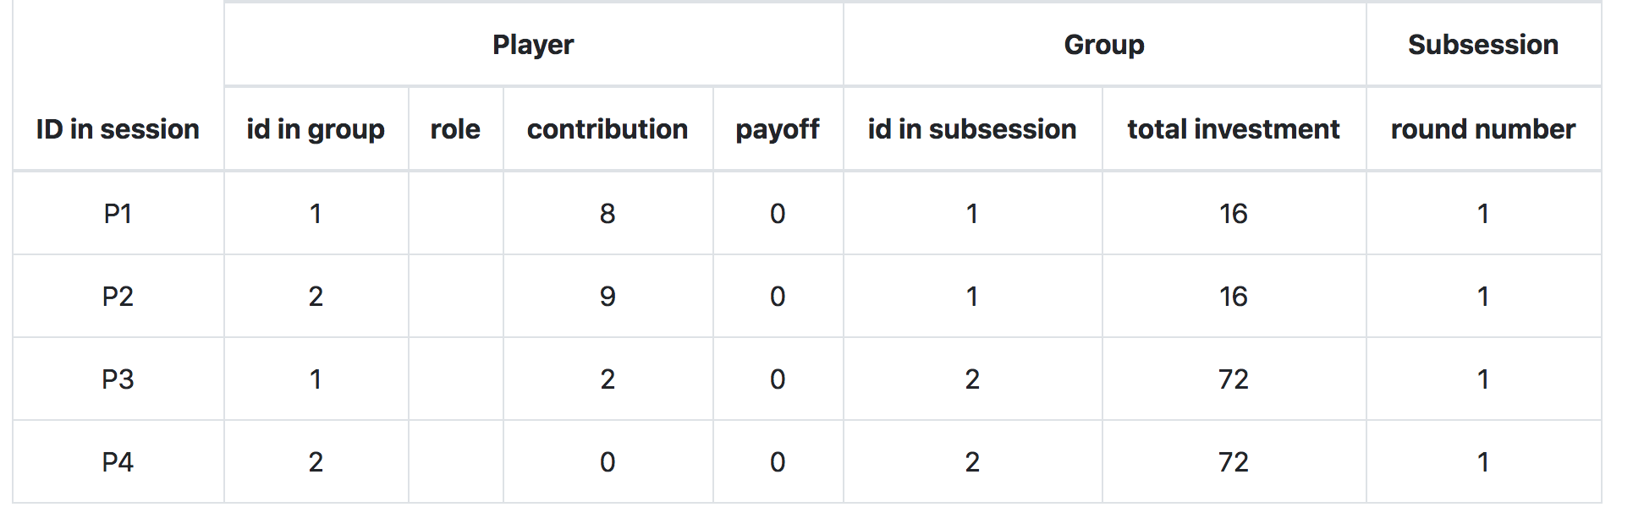
creating_session method
The following code will randomize total investment per group and contribution per individual player:
Result:

Slide 29
player model
built-in attributes:
id_in_group
id_in_subsession
payoff
round_number
DB referrals: participant, group, subsession, session
built-in methods:
get_others_in_group()
get_others_in_subsession()
in_round, in_previous_rounds, in_all_rounds

Slide 30
group model
built-in attributes:
id_in_subsession
round_number
DB referrals: subsession, session
built-in methods:
get_players()
set_players()
get_player_by_id(ID)
get_player_by_role(ROLE)

Slide 31
Anatomy of an oTree Page
Page creation:
class definition
template
When/if/for whom it is shown:
position in page_sequence
is_displayed method
What is shown:
vars_for_template method
What to do next:
before_next_page method

Slide 32
Anatomy of an oTree Page
class MyPage(Page):
form_model = 'player'
form_fields = ['my_field']
page_sequence = [MyPage]

Slide 33
Field form(s) on a template
{% fieldform player.my_field label= ‘Enter something’ %}
OR:
{% for field in form %}
{% formfield field %}
{% endfor %}
OR:
{% formfields %}
OR:
{{ form }}

Slide 34
Methods of an oTree Page
BEFORE page is shown:
is_displayed (should return True if page is to be shown)
vars_for_template (should return variables in a form of dictionary)
AFTER page is shown:
before_next_page

Slide 35
Dynamic set of forms
in Page class:
class MyPage(Page):
def get_form_fields(self):
if self.player.treatment == 'A':
return ['a', 'b']
else:
return ['c', 'd']

Slide 36
Dynamic min/max
you have a field donation; different endowments
in Page class:
class MyPage(Page):
def donation_max(self):
return self.player.endowment

Slide 37
Templates: using variables
In a template you can access variables defined in vars_for_template of the specific page:
{{ var }}
You can also use lists and dictionaries
You can also access any variable in Constants, Player, Group…
{{ player.payoff }}
{{ participant.payoff }}

Slide 38
GIT: creation
Go to your project folder in terminal/cmd/bash…
git init
git add .
git commit –m 'Commit message'
Create a git repository in www.github.com
git add remote origin LINK_TO_GIT
git push origin master --set-upstream
More info: http://rogerdudler.github.io/git-guide/

Slide 39
GIT: pushing update
Go to your project folder in terminal/cmd/bash…
git add .
git commit –m 'Commit message'
git push

Slide 40
Heroku
create git first!
heroku create APP_NAME
heroku addons:create heroku-redis
git push heroku master
heroku run otree resetdb

